Slide 1
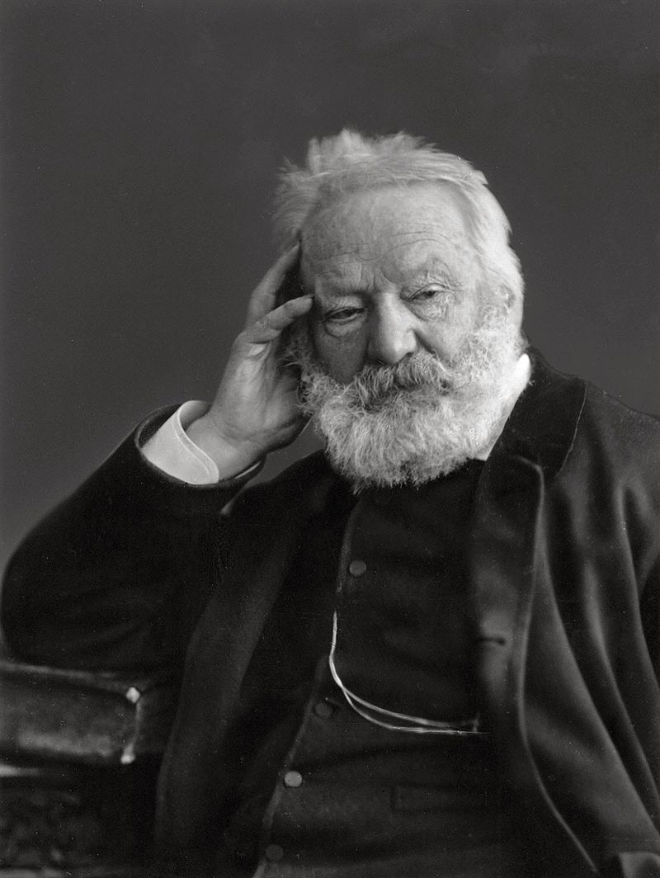
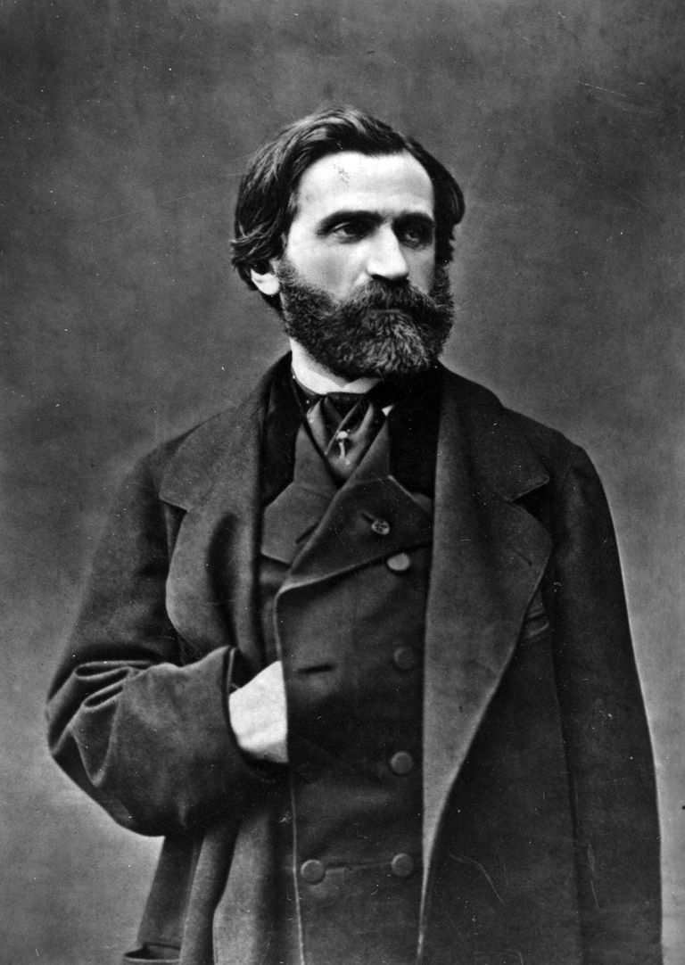
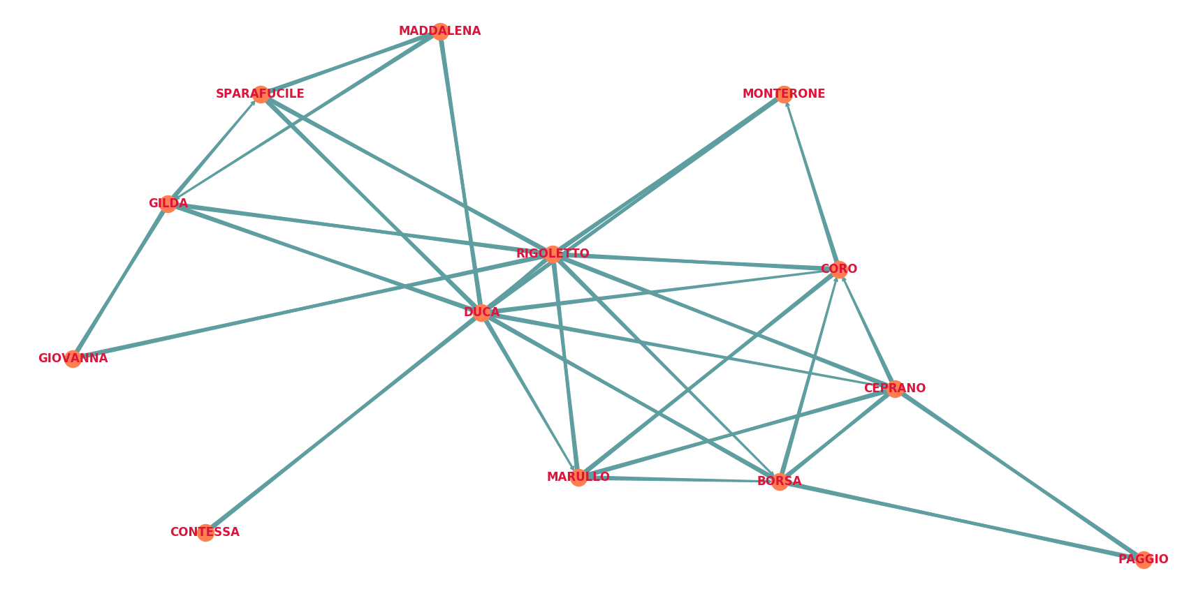
Play-Libretto comparison
Verdi – Hugo : “le roi s’amuse” and “Rigoletto”

Slide 2
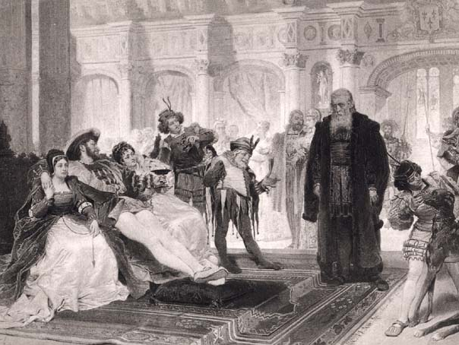
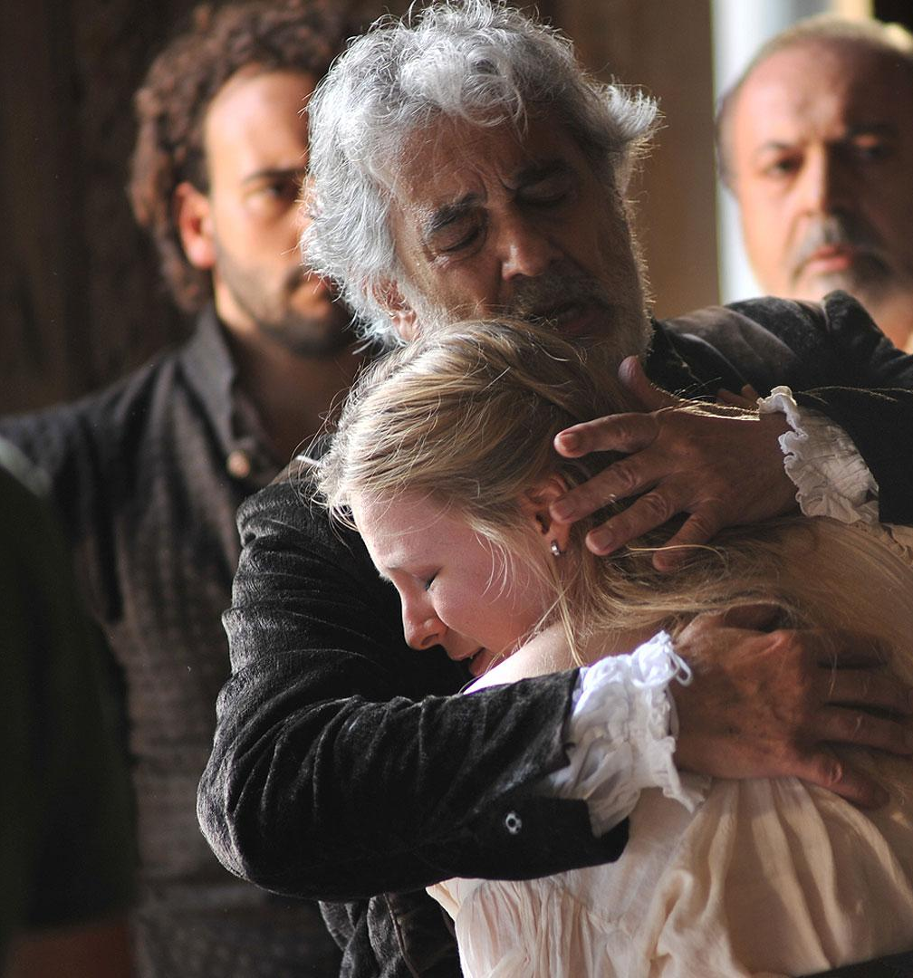
Notes:
Rigoletto is the duke's buffoon. The Duke has a bad habit of seducing the wives or daughters of his courtiers. Rigoletto makes fun of them.
Rigolleto has a daughter, who is his only reason for living. To get revenge from his jokes, the courtiers decide to abduct his daughter and bring her to the Duke.
Rigolleto wants revenge in turn.

Slide 3
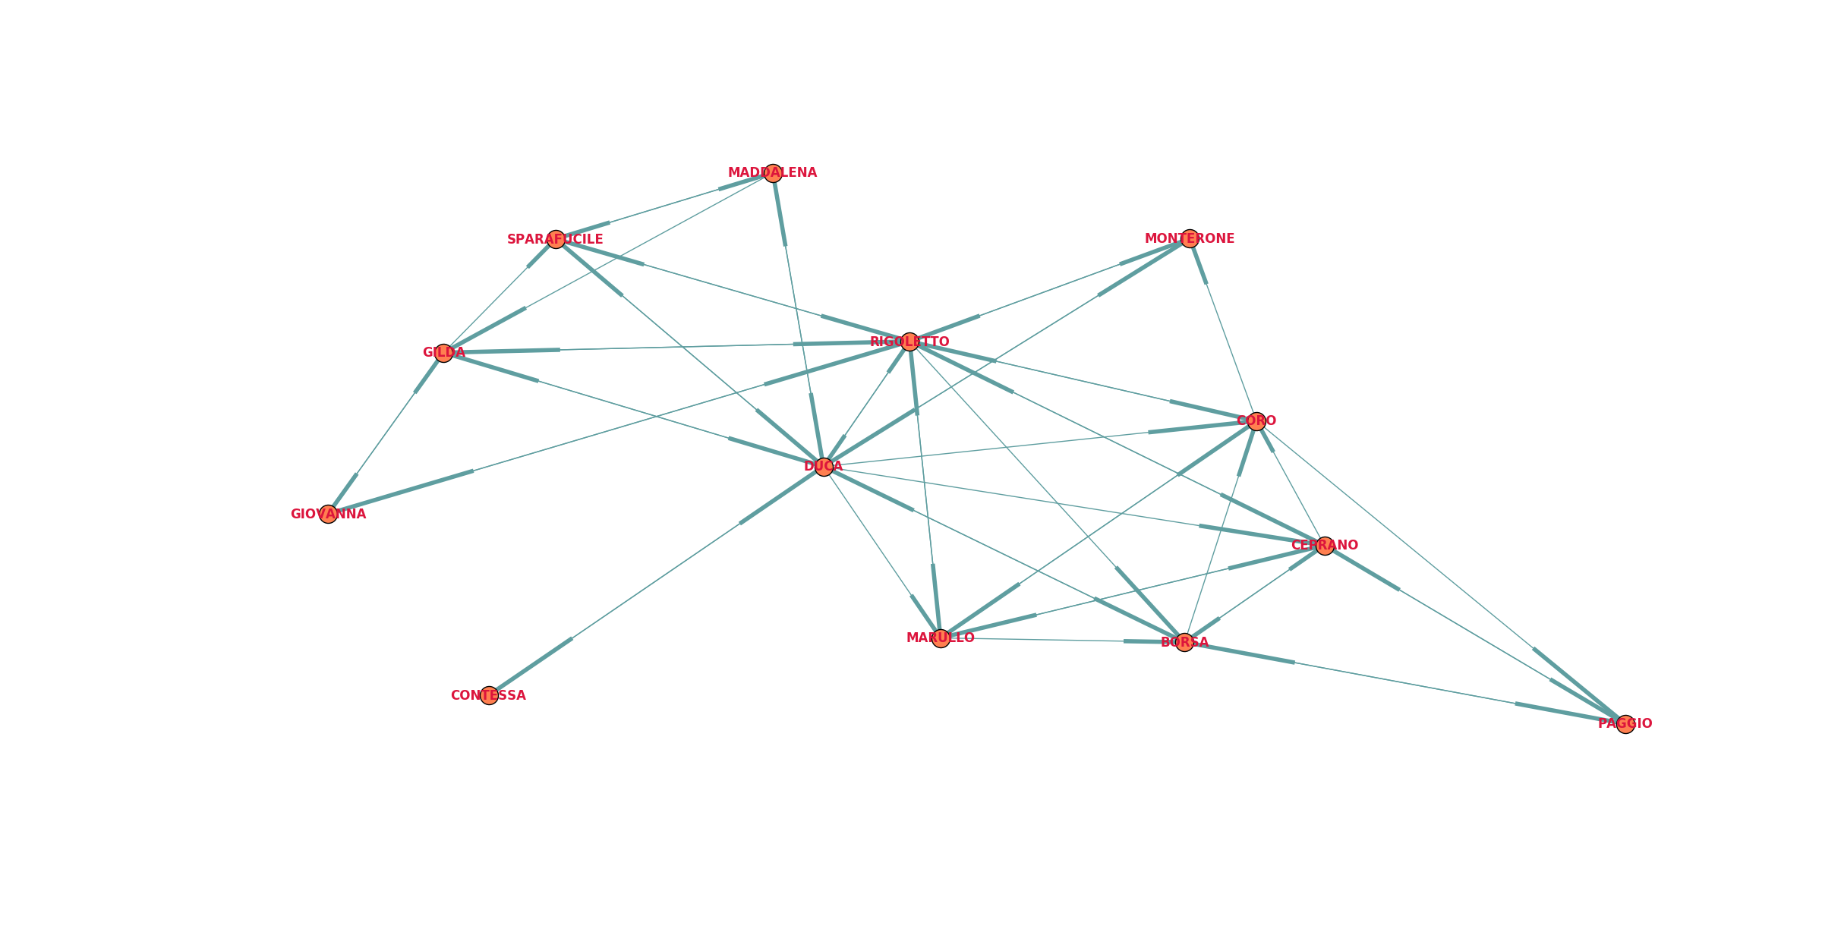
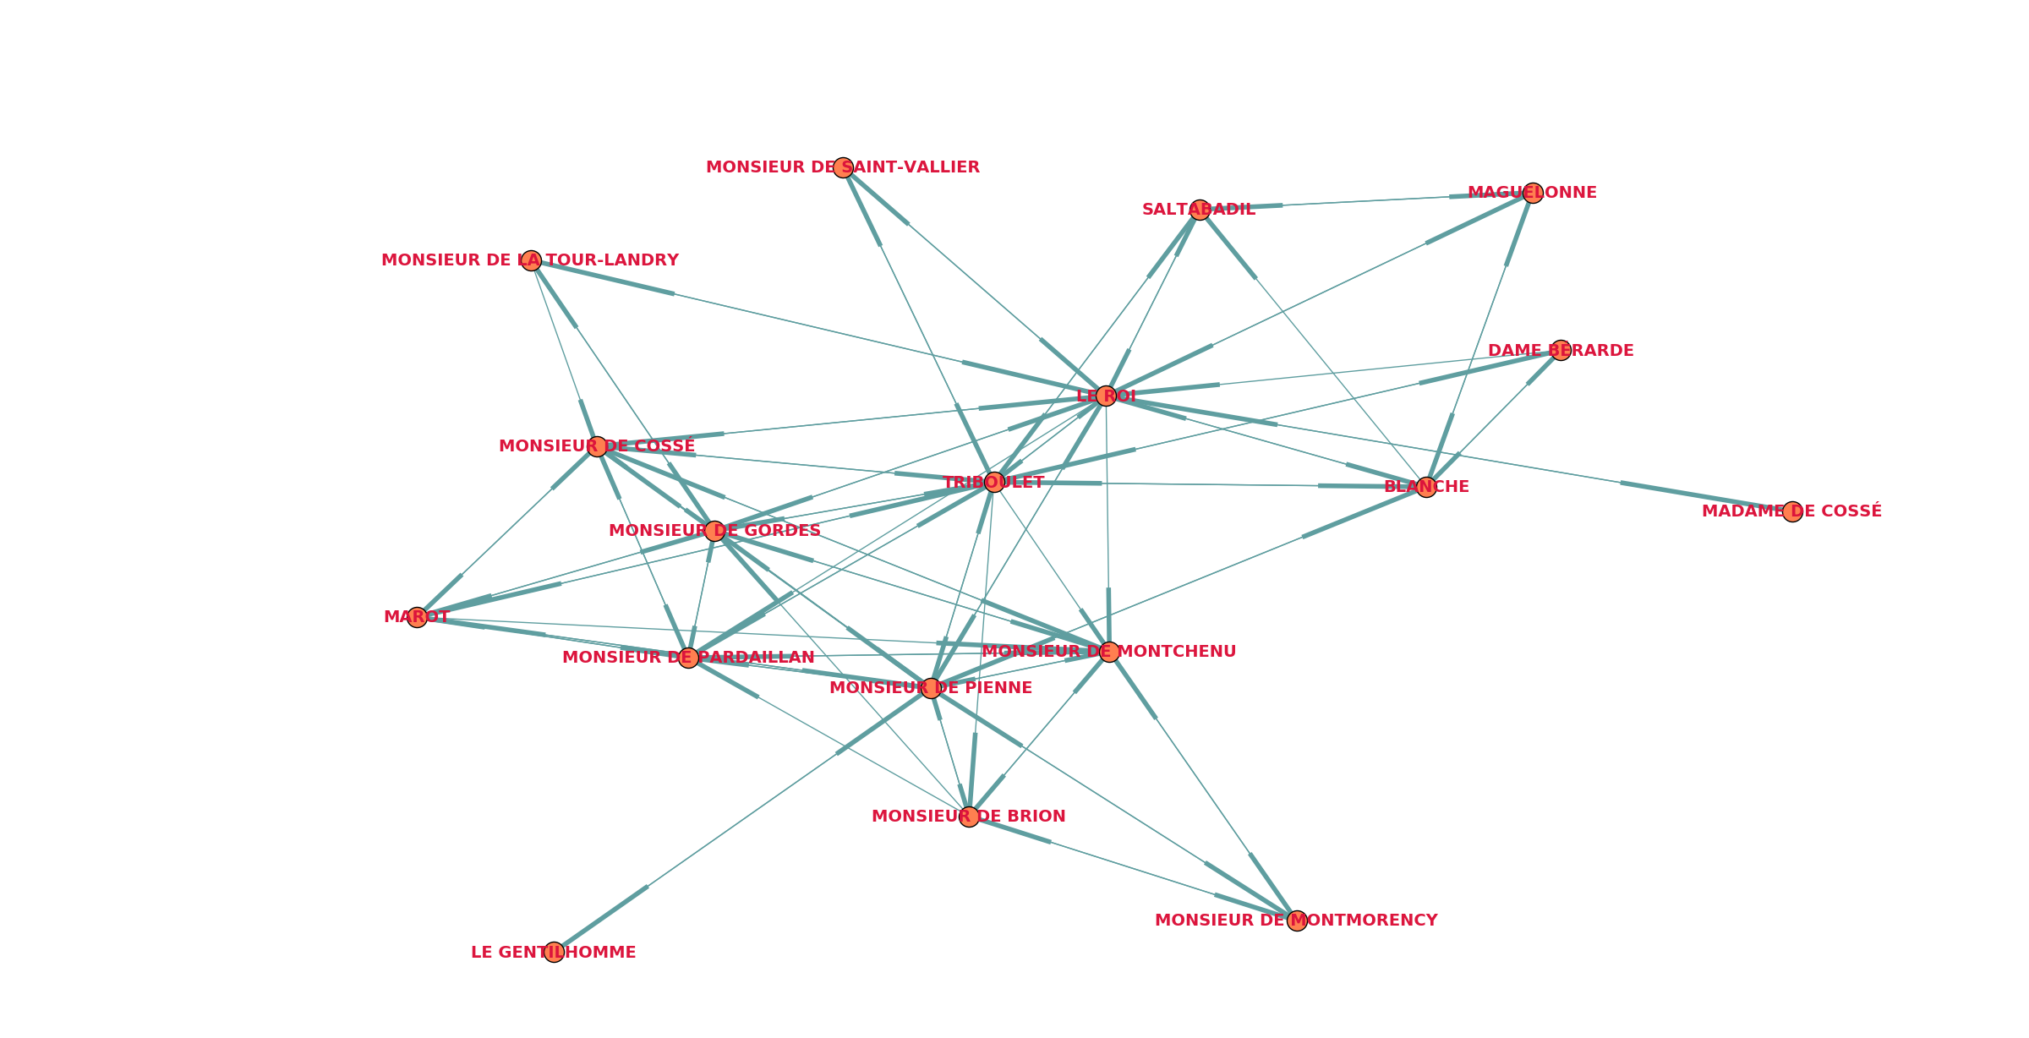
Two intersecting areas : private sphere and court
Rigoletto/Triboulet and Duca/King stay in the centre

Slide 4
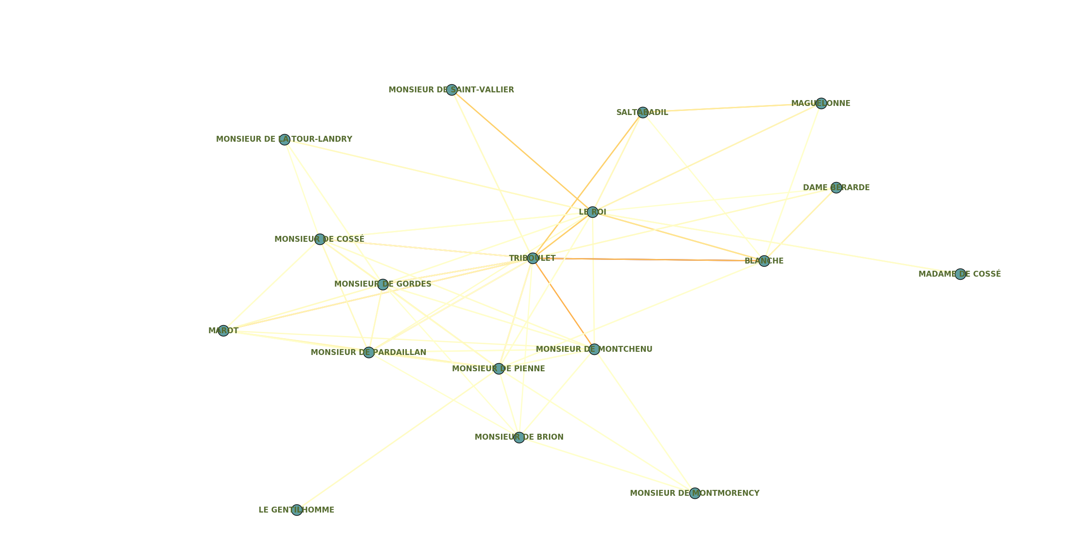
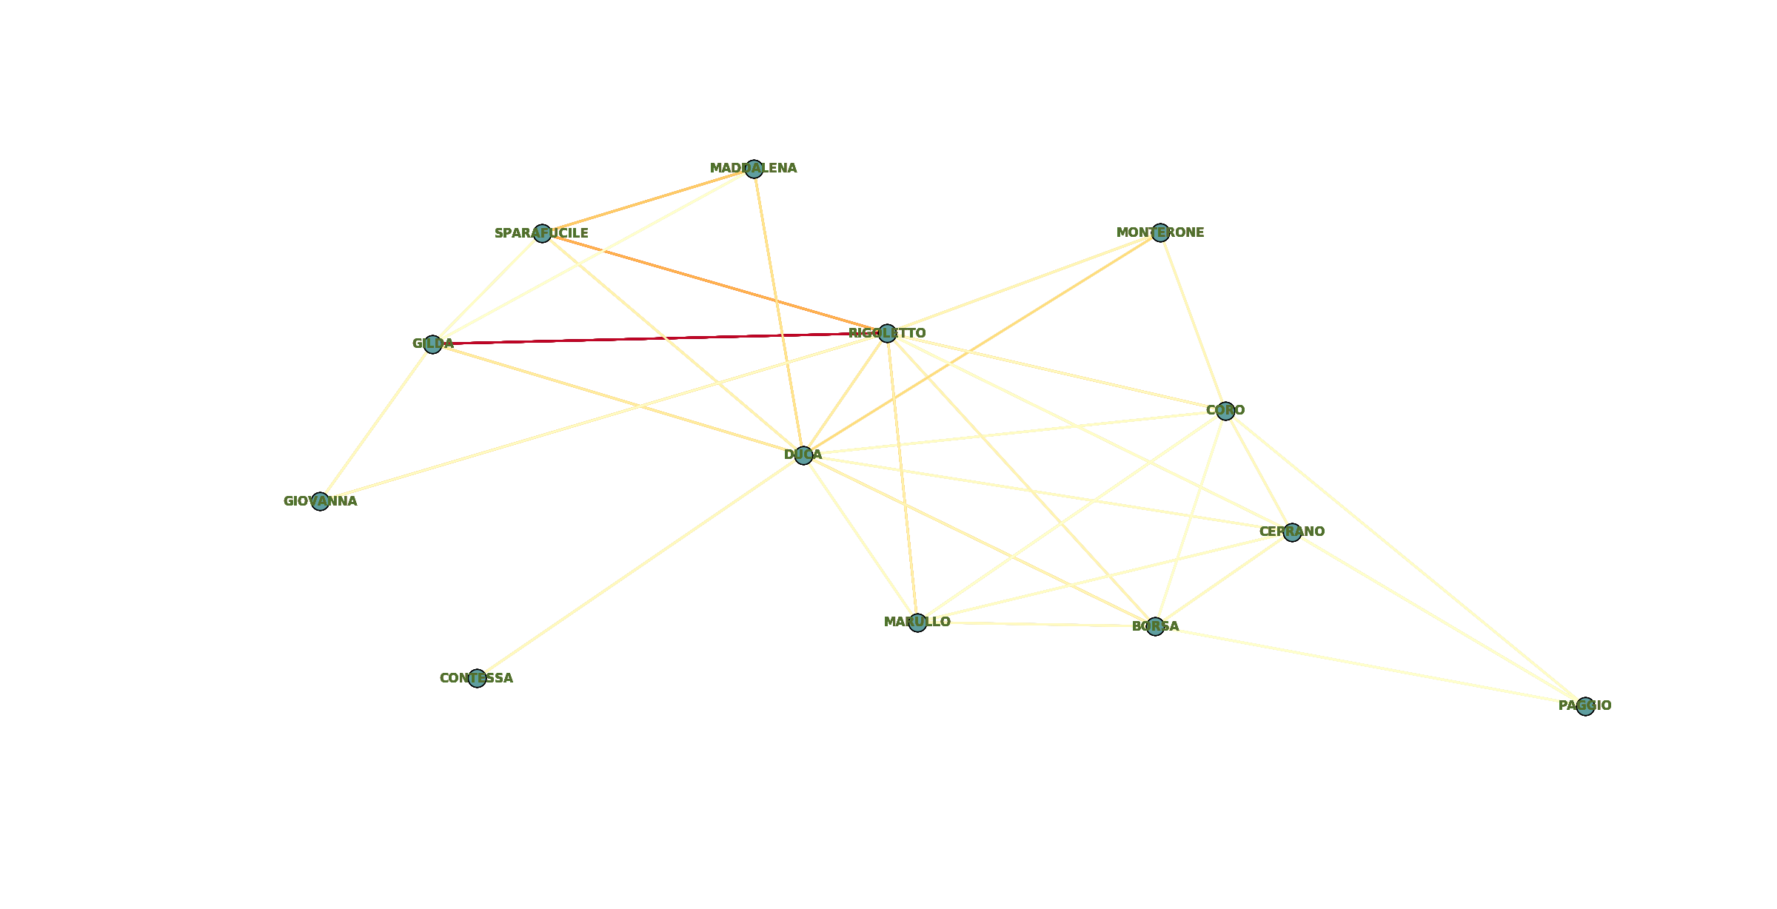
Intense connection between Gilda and Rigoletto
Strong links in the “revenge area”
Stronger connection between triboulet and the king
Political issues take on more prominence

Slide 5
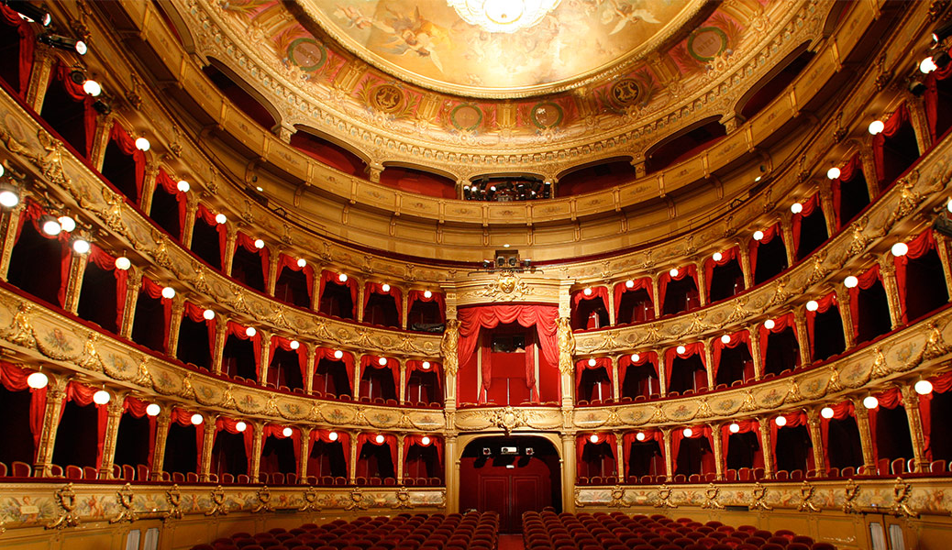
Play-Libretto comparison
Shakespeare – Verdi:
Macbeth
Othello
Beaumarchais - Mozart:
Les noces de Figaro
Beaumarchais - Rossini:
Le barbier de Séville

